Slide 1
Deep Learning
Deep Learning for Timeseries
Chapter 10
Vera Hollink
2025

Slide 2
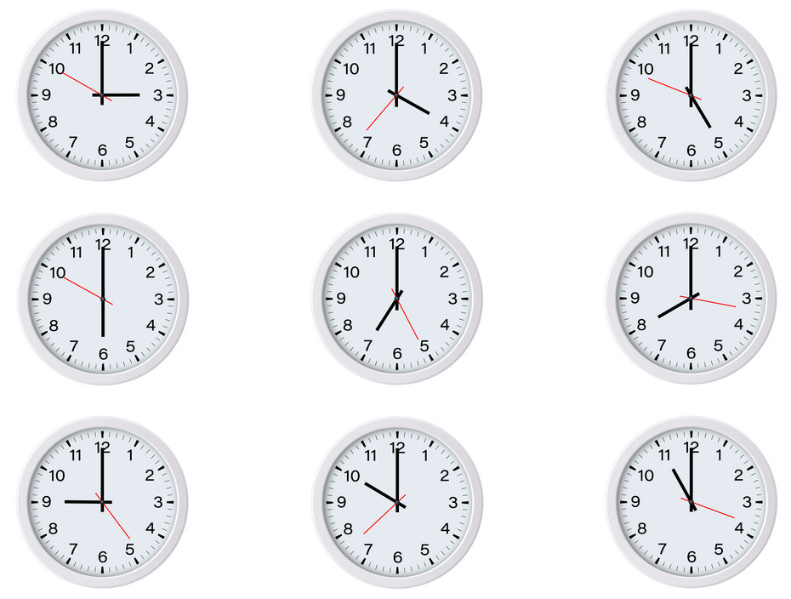
Sequence data

Slide 3
Sequence data
Until now: variables – values
Variables not ordered
[temperature, humidity, fertilizer] ➔ plant growth
Sequence:
Ordered values
[I, see, a, black, cat]
[10°, 11°, 13°, 12°, 14°, 15°]

Slide 4
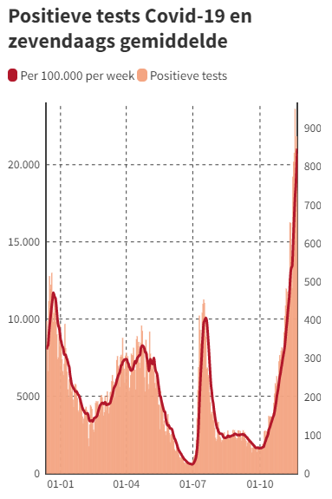
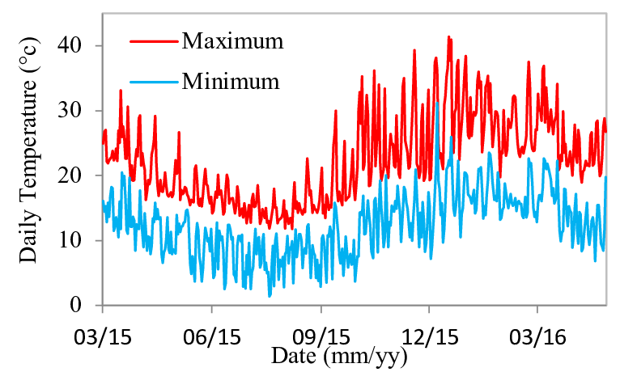
Types of sequence data
Time series
Time vs value
Examples: weather, infections
Periodicity/seasonality

Slide 5
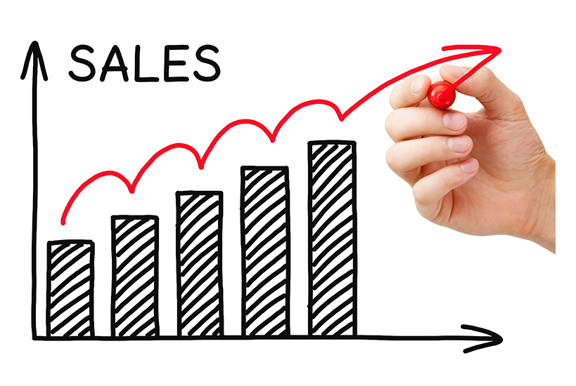
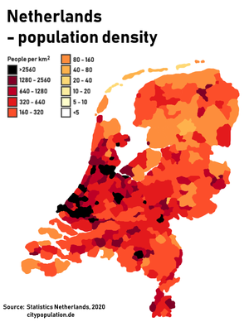

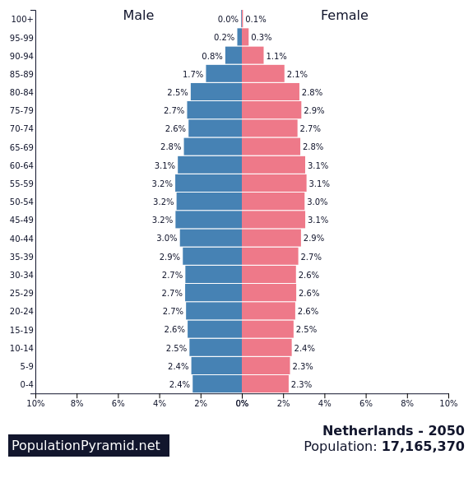
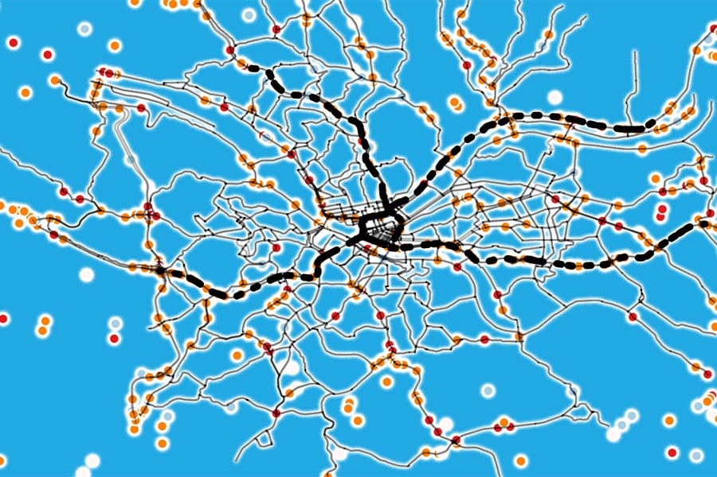
Time series examples
StiSales
StiStock prices
StiDemographics
StiTraffic

Slide 6
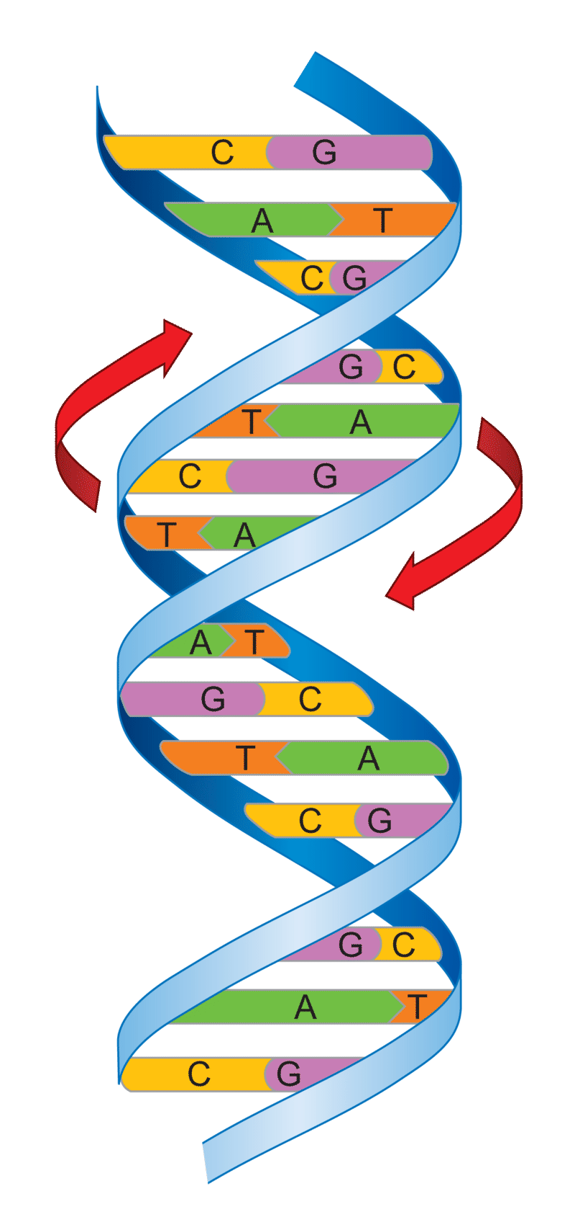
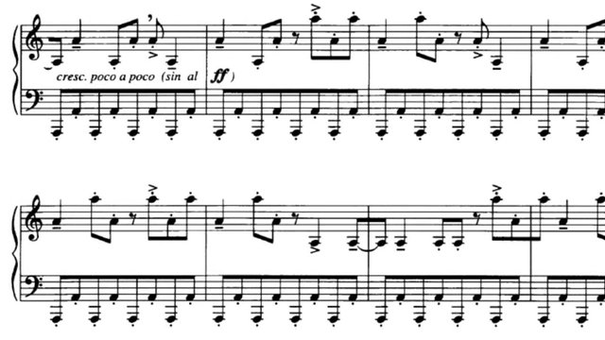
Types of sequence data
Non-timeseries sequence data
Text
Music
DNA
Event logs

Slide 7
Sequence processing tasks
Forecasting
Tomorrow’s temperature
Classification
Language detection
Event detection
Detect hot words ‘Ok Google’
Anomaly detection
Hacking, machine failure

Slide 8
Data preparation: from sequence to samples
Daily max temperatures: [10, 11, 13, 12, 14, 15, 21, 23, 22]
Prepare input
Sampling rate:
How often do you measure (every second, minute, day, …)
Reduce sampling rate by taking every n^{th} value (or mean, max, min, or mode over n values)
Sequence length:
Length of history used
e.g. sequence length 3 [10, 11, 13], [11, 13, 12], [13, 12, 14], [12, 14, 15], [14, 21, 23],...

Slide 9
Data preparation: from sequence to samples
Daily max temperatures: [10, 11, 13, 12, 14, 15, 21, 23, 22]
Prepare output
Delay
How far in the future do you predict (from start of sequence)
e.g. delay 5 days
[10, 11, 13] ➔ 15
[11, 13, 12] ➔ 21
[13, 12, 14] ➔ 23 …

Slide 10
Data preparation: from sequence to samples
predict 5 days in advance (=24*(14+5) hours from start of sequence)
delay = 24 * (14+5-1)
train_dataset = keras.utils.timeseries_dataset_from_array( data = raw_data[:-delay], targets=raw_data[delay:], sampling_rate=24, sequence_length=14
)
target for sample n is data point n+delay
use every 24th data point (from hours to days)
use data of past 14 days

Slide 11
Exercise: from sequences to samples
Stock prices: [28, 31, 45, 26, 47, 48, 50, 28, 30, 35, 40, 50, 52] [14, 13, 21, 24, 25, 7, 9, 12, 11, 30, 25, 26, 27]
Sampling rate 2
Sequence length 3
Delay 6 (from beginning of sample)
Exercise: create samples (input and output)

Slide 12
Exercise: from sequences to samples
[28, 31, 45, 26, 47, 48, 50, 28, 30, 35, 40, 50] [14, 13, 21, 24, 25, 7, 9, 12, 11, 30, 25, 26]
Sampling rate 2
[28, 45, 47, 50, 30, 40] [14, 21, 25, 9, 11, 25]
Sequence length 3
[28, 45, 47] [45, 47, 50] [47, 50, 30] [50, 30, 40] [14, 21, 25] [21, 25, 9] [25, 9, 11] [9, 11, 25]
Delay 6 (from beginning of samples)
50, 30, 40
9, 11, 25
Samples
[28, 45, 47] ➔ 50 [14, 21, 25] ➔ 9 [45, 47, 50] ➔ 30 [21, 25, 9] ➔ 11 [47, 50, 30] ➔ 40 [25, 9, 11] ➔ 25

Slide 13
Multiple input variables
Date | Temperature | Wind speed | Precipitation | humidity
1-1-2023 | 4 | 7 | 0 | 90
2-1-2023 | 5 | 8 | 2 | 88
3-1-2023 | 3 | 8 | 3 | 91
4-1-2023 | 6 | 7 | 1 | 92
5-1-2023 | 2 | 12 | 8 | 94
More data → better predictions
Use multiple predictors, multiple timesteps back

Slide 14
Multiple input variables
Date | Temperature | Wind speed | Precipitation | humidity
1-1-2023 | 4 | 7 | 0 | 90
2-1-2023 | 5 | 8 | 2 | 88
3-1-2023 | 3 | 8 | 3 | 91
4-1-2023 | 6 | 7 | 1 | 92
5-1-2023 | 2 | 12 | 8 | 94
Input dimensions: timesteps x num_variables
Output dimensions: ouput_variable
[[4,7,0,90],[5,8,2,88],[3,8,3,91]] ➔ 6
[[5,8,2,88],[3,8,3,91],[6,7,1,92]] ➔ 2

Slide 15
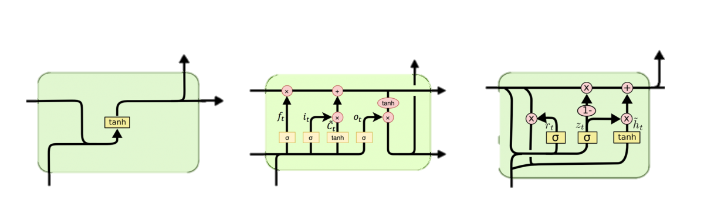
Deep learning networks for sequences

Slide 16
Feedforward Neural Network
Feedforward NN requires 1d input. How?
Flatten input: put all timesteps after each other [[4,7,0,90],[5,8,2,88],[3,8,3,91]] → [4,7,0,90,5,8,2,88,3,8,3,91]
inputs = keras.Input(shape=(sequence_length, raw_data.shape[-1]))
x = layers.Flatten()(inputs)
x = layers.Dense(16, activation="relu")(x)
outputs = layers.Dense(1)(x)
model = keras.Model(inputs, outputs)
Input dimensions: timesteps x num_variables
Flatten input
Dense layer(s)

Slide 17
Feedforward Neural Network for timeseries
Limitations:
process whole sample at once
→ no memory, no order

Slide 18
1D Convolutional Neural Network
Input: timesteps x num_variables
Slide per variable 1D window over timesteps
Date | Temperature | Wind speed | Precipitation | humidity
1-1-2023 | 4 | 7 | 0 | 90
2-1-2023 | 5 | 8 | 2 | 88
3-1-2023 | 3 | 8 | 3 | 91
4-1-2023 | 6 | 7 | 1 | 92
5-1-2023 | 2 | 12 | 8 | 94

Slide 19
1D Convnet for timeseries
Window size: look at 24h
inputs = keras.Input(shape=(sequence_length, raw_data.shape[-1]))
x = layers.Conv1D(8, 24, activation="relu")(inputs)
x = layers.MaxPooling1D(2)(x)
x = layers.Conv1D(8, 12, activation="relu")(x)
x = layers.MaxPooling1D(2)(x)
x = layers.Conv1D(8, 6, activation="relu")(x)
x = layers.GlobalAveragePooling1D()(x)
outputs = layers.Dense(1)(x)
model = keras.Model(inputs, outputs)
Limitations:
Same pattern is searched everywhere: all timesteps equal weight
→ order is mostly lost
Number of nodes/filters

Slide 20
Recurrent Neural Networks (RNN)
process sample timestep-by-timestep
keep state (memory)

Slide 21
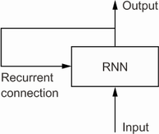
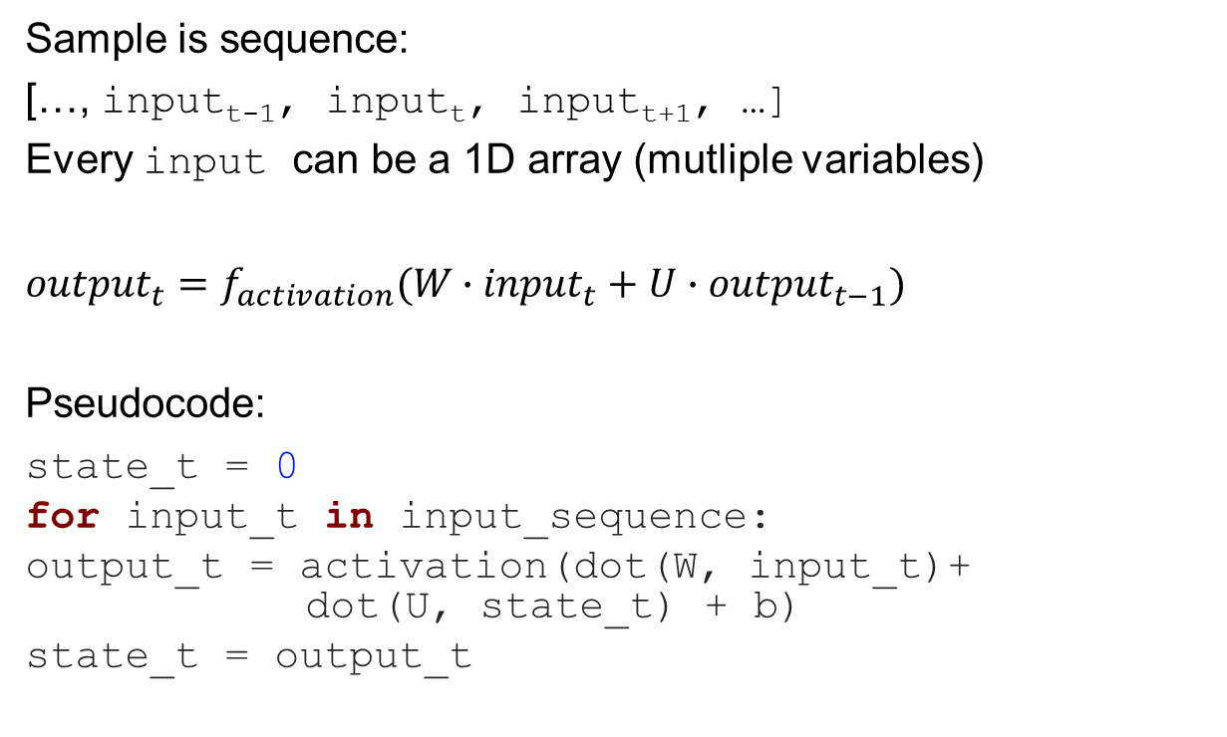
Simple RNN
Sample is sequence:
[…, input_{t-1}, input_{t}, input_{t+1}, …]
Every input can be a 1D array (mutliple variables)
$${output}_{t}=f_{activation}(W∙{input}_{t}+U∙{output}_{t−1})$$
Pseudocode:
state_t = 0
for input_t in input_sequence:
output_t = activation(dot(W, input_t)+ dot(U, state_t) + b)
state_t = output_t

Slide 22
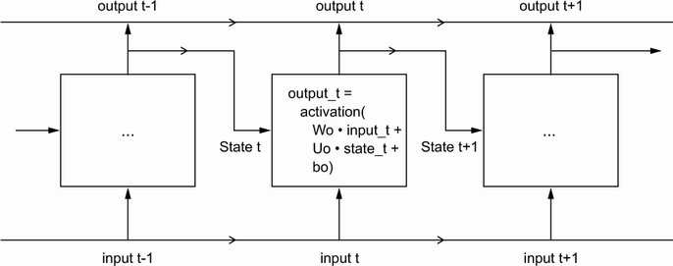
Simple RNN
Output
Sequence […, output_{t-1}, output_{t}, output_{t+1}, …]
e.g. translation
Last output output_{n}
Classification, e.g. language detection, weather prediction
output can be a 1D array (multiple variables)

Slide 23
More advanced types of RNN’s
Disadvantage SimpleRNN
Vanishing gradient problem: information from far back has little influence
RNNs with longer memory:
Long Short-Term Memory (LSTM)
Gated Recurrent Unit (GRU)

Slide 24
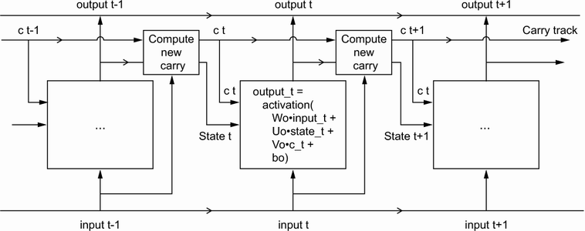
LSTM
Carry track that transports information
enables the NN to memorize: e.g. is the subject singular/plural

Slide 25
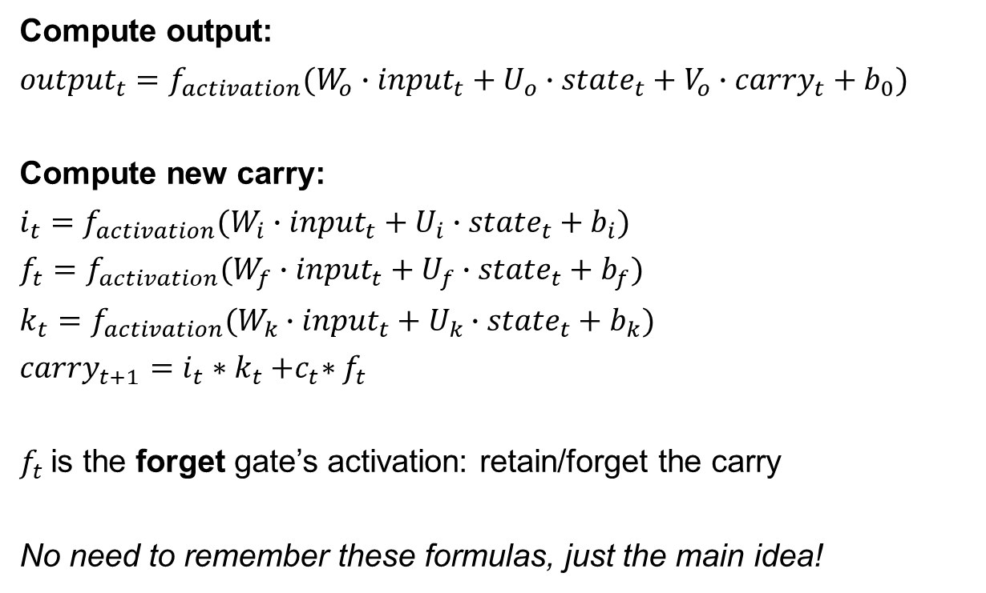
LSTM
Compute output:
$${output}_{t}=f_{activation}(W_{o}∙{input}_{t}+U_{o}∙{state}_{t}+V_{o}∙{carry}_{t}+b_{0})$$
Compute new carry:
$$i_{t}=f_{activation}(W_{i}∙{input}_{t}+U_{i}∙{state}_{t}+b_{i})$$
$$f_{t}=f_{activation}(W_{f}∙{input}_{t}+U_{f}∙{state}_{t}+b_{f})$$
$$k_{t}=f_{activation}(W_{k}∙{input}_{t}+U_{k}∙{state}_{t}+b_{k})$$
${carry}_{t+1}=$ $i_{t}∗k_{t}{+c}_{t}∗f_{t}$
$f_{t}$is the forget gate’s activation: retain/forget the carry
No need to remember these formulas, just the main idea!

Slide 26
Finetuning RNNs: dropout
LSTM has many parameters (all those W’s, U’s and b’s)
It needs a lot of training data
It easily overfits
Solution: regularization by dropout

Slide 27
LSTM using keras
Dropout values of state
LSTM layer with 32 nodes
model = models.Sequential()
model.add(layers.LSTM(32, recurrent_dropout=0.25, return_sequences=False)
model.add(layers.Dropout(0.5))
Model.add(layers.Dense(1))
model.compile(optimizer="rmsprop", loss="mse", metrics=["mae"])
model.fit(train_dataset, epochs=50, validation_data=val_dataset)
False: return only last output
True: return output sequence
Dropout output of LSTM
Dense layer on top to compute final output

Slide 28
Finetuning RNNs: deeper network
Stacking recurrent layers
Pass all information from one layer to the next:
model.add(layers.LSTM(32, recurrent_dropout=0.25, return_sequences=True)
model.add(layers.LSTM(32, recurrent_dropout=0.25, return_sequences=True)
model.add(layers.LSTM(32, recurrent_dropout=0.25, return_sequences=False)
Disadvantage?
even more parameters ➔ even more overfitting

Slide 29
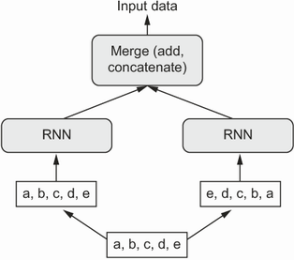
Finetuning RNNs: bidirectional RNN
Process sequence in both directions
[10, 11, 13, 12, 14, 15, 21, 23, 22]
layers.Bidirectional(layers.LSTM(16))(inputs)
Useful?
If sequence could be reversed (e.g. text)
Not if last timesteps are most important

Slide 30
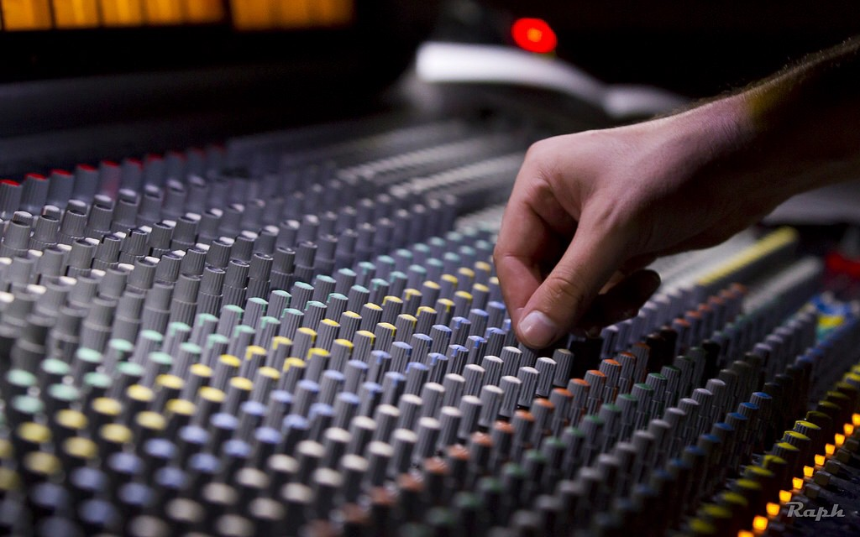
Finetuning RNNs
Further things to try:
Longer/shorter sequences
Different sampling rate
GRU instead of LSTM
More/less nodes per layer
More dense layers
But remember Occam’s razor: simpler is usually better!

Slide 31
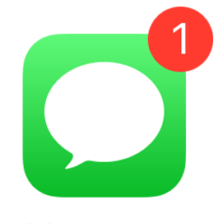
Take home message
Preprocessing
sequence ➔ samples
Dense model, 1D convnet
Order lost
RNN
Process sequence step-by-step
State ‘memorizes’ previous timesteps
Input: value at time t, output time t-1
Output: output time t
Types of RNN’s
(SimpleRNN)
LSTM
GRU

